Slide 1

PROJECT
Zeynep Gizem ÇETİNCİ YALÇIN

Slide 2
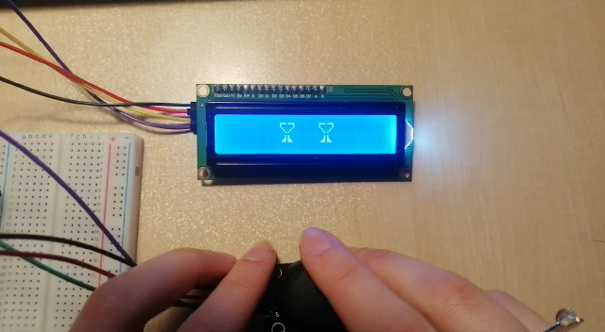
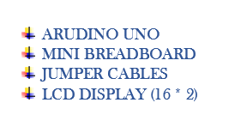
MAKE ARDUINO LCD GAME AND ANIMATION

Slide 3
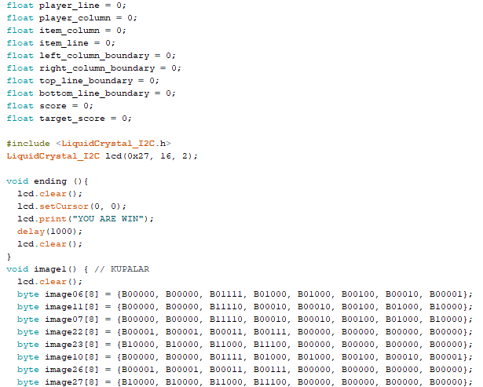
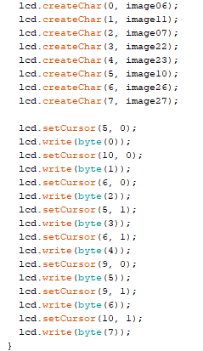
MAKE ARDUINO LCD GAME AND ANIMATION

Slide 4
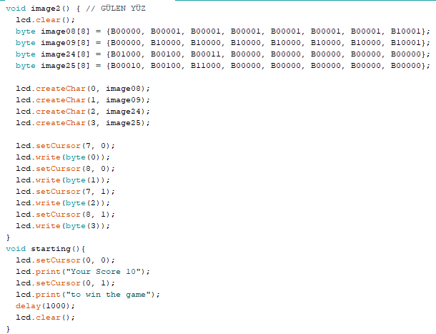
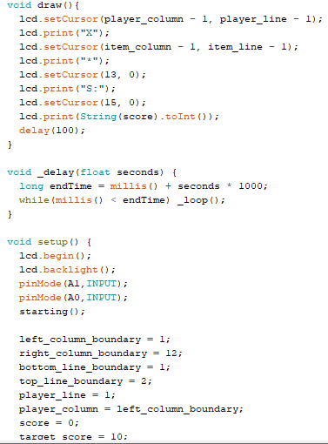
MAKE ARDUINO LCD GAME AND ANIMATION

Slide 5
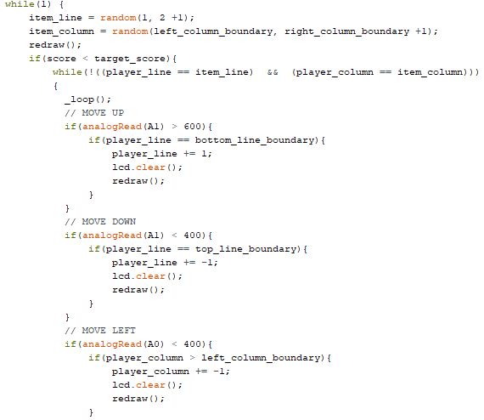
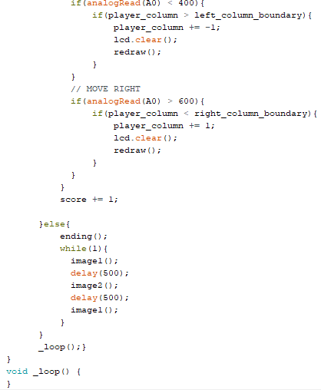
MAKE ARDUINO LCD GAME AND ANIMATION

